Slide 1
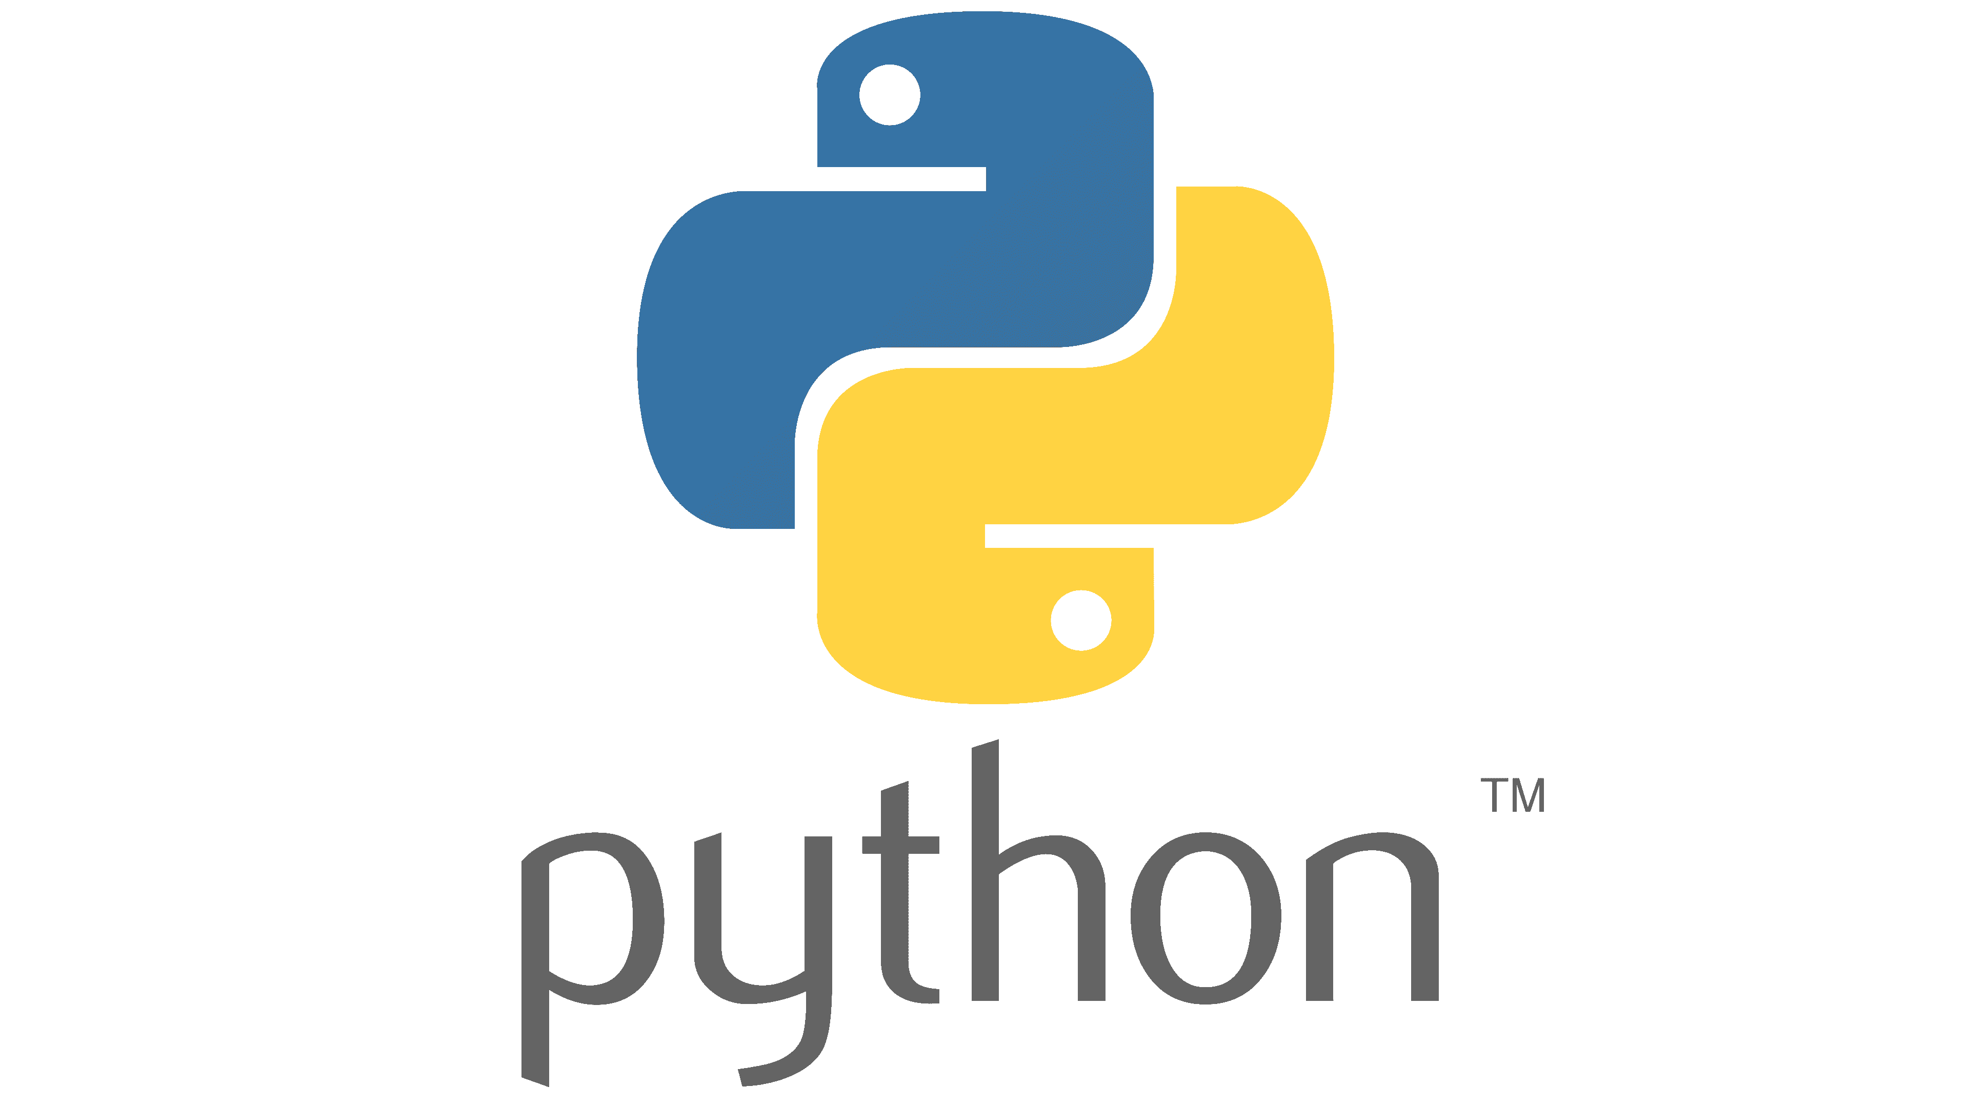
By
Divya Premkumar Patil
Libity Infotech

Slide 2
Day 1
Introduction to Trainer
Introduction to Internship Training
Overview of the Internship Program
Introduction to Python
History of Python
Features of Python
Uses of Python
Applications of Python
Which Companies Uses Python
Installation of python
Installation

Slide 3
Introduction of Python
Python is a General- purpose, High level Programming language(HLL),
OR
Python is a general purpose, interactive, interpreted, object-oriented and HLL.

Slide 4
History of Python
It was created by Guido Van Rossum
During 1985-1990, and released in 1991, i.e. On 20th Feb 1991
He developed this at NRI(National Research Institute)

Slide 5
Why is the word Python?
There was a comedy show named as “Monty Python’s Flying Circus” (1969 to 1974) on popular TV show BBC.
Guido thought that why I don’t keep it / give this language a fun loving name, so he named this language as Python.

Slide 6
Python’s Uses
Desktop Applications
Web Applications
Database Applications
Networking Applications
Games
Data Analysis
Data Science
Machine Learning
Artificial Intelligence Applications
IOT Applications.

Slide 7
Which Companies Uses Python?
Google
Pinterest
YouTube
Facebook
Drop box
Instagram
Quora
NASA

Slide 8
Why Python?
Python works on different platforms.(Windows, Mac,Linux, Raspberry Pi, etc)
Python has a simple syntax similar to the English Language.
Python runs on an interpreter system, means that code can be executed as soon as it is written.
Python can be treated in a procedural way, an object oriented way or in a functional way.

Slide 9
Two parallel versions of python
The most recent parallel version of python is Python 3, Python 2 and Python 3 are not compatible versions of each other.
It is not at all necessary that version 3 will run/ execute all the features of version2.
Python 3 is developed as independent language.
Python3 is not an enhanced version of Python2, it is not that a program running in python 2 will definitely run on Python 3, Nooooo....

Slide 10
Installation of Python
Open a web browser➔ www.python.org/downloads
Follow the link for the windows installer/ select OS
Download now➔ Install Python

Slide 11
IDE Pycharm
Google→ Pycharm Jetbrains →www.jetbrains.com →Download now→ choose OS→Download for community version →Install→Pin to taskbar or place it on desktop→Make a new folder for saving your program(Python Projects)
For Programming/ create project
Open Pycharm➔ create New project→..../..../untitled(write the project name here which you want)→create
To create a new file→Name→Python file→.py file(Ex:Hello.py)

Slide 12
Write a program now:
Extension== .py
First Program
print(“Hello World!!!”)
Output → Hello World!!!

Slide 13
Features of Python
Simple and easy to learn:
▪ Ex: print(“Hi Rahul”)
▪ Output: Hi Rahul
Only 35 keywords are required for Python
Freeware and Open source:
Freeware: We do not require to pay any money, for any kind of purpose such as license related issues, etc, you can install and run it.
Open Source: You are able to see the source code how it is implemented.
eg: Suppose if the internal implementation is not good we can change the implementation / i.e we can customize the implementation.

Slide 14
High Level Programming Language:- A language which humans can understand very well.
Platform Independent:
Now x=10
if x==10:
print(“hello”)
This is the code written on Windows OS machine, the same program can be run on Unix,Linux, Mac OS.
Write once & Run anywhere (WORA)

Slide 15
Portability: Moving python program from one platform to another platform very easily without performing any changes.
Dynamically Typed Language:- In Python there is no need to declare type for the variable whenever we are assigning the value, based on that value type, automatically type will be considered.
x=10 ➔int
print(type(x)) → This shows type of the variable

Slide 16
Both Procedure Oriented and Object Oriented
Interpreted: Python can be directly run/executed.
Extensive Library (import function)
Ex: Build house, Buy House
import math
print(math.sqrt(4))
Output→ 2

Slide 17
Limitation
Performance:- Since it is an interpreted language, line by line
execution takes place.

Slide 18


